Slide 1

Fundamentals of IT
BIT-01 BBA-Ist year MMMUT, Gorakhpur
A
PDF on UNIT-1
Introduction to Computer Hardware/Software

Slide 2
Introduction
A computer is an electronic device that accept data (input) and, process data arithmetically and logically, produce information (output).
It is divided in two main categories
Hardware
Software

Slide 3
Hardware
Four components of a computer system:
CPU - central processing unit (memory unit, control unit, arithmetic logic unit)
Makes decisions, performs computations, and delegates input/output requests
Memory: Disk Drives, CD drives, Tape drives, USB flash drives.
Stores information
Input devices: Keyboard, Mouse,
Gets information from the user to the computer
Output devices: monitor
Sends information from computer to the user

Slide 4
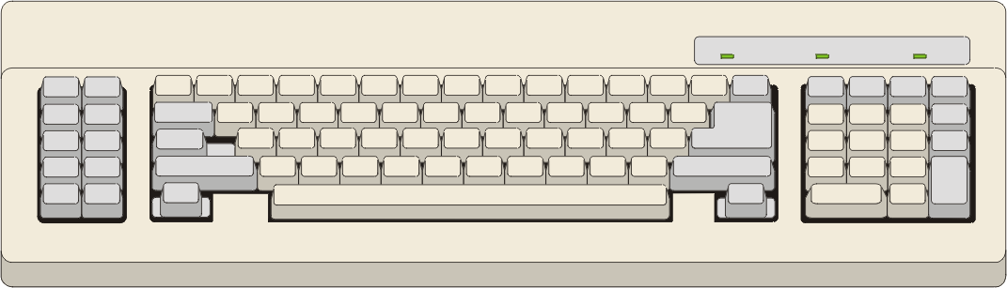
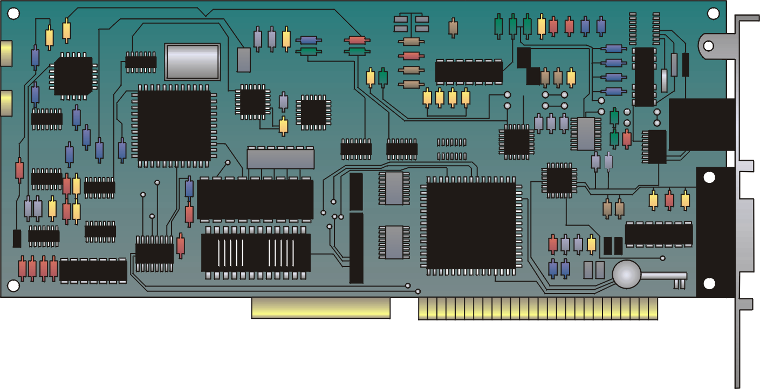
Hardware

Slide 5
Software
Software
System
Software
Application
Software

Slide 6
Software
Application software
Easy-to-use programs designed to perform specific tasks
System software
Programs that support the execution and development of other programs
Two major types
Operating systems
Translation systems (compilers & linkers)

Slide 7
Copyright © 2000 by Brooks/Cole Publishing Company A division of International Thomson Publishing Inc.

Slide 8
Computer Software Relationships
User Interface
Application Programs
User Interface
Operating System
User
Interface
Basic Input and Output Services (BIOS)
needed for a computer to boot up
Computer Hardware

Slide 9
Application Software
Application software makes computer popular and easy to use.
Common application software:
Microsoft Word
PowerPoint
Netscape, Internet Explorer
Photoshop, Photo-Paint

Slide 10


Operating System
Controls and manages the computing resources
Examples
Windows, Unix, MSDOS,
Important services that an operating system provides:
Security: prevent unauthorized users from accessing the system
Commands to manipulate the file system
Input and output on a variety of devices
Window management

Slide 11
Peripherals
Peripherals are commonly divided into three kinds: input devices, output devices, and storage devices (which partake of the characteristics of the first two).
An input device converts incoming data and instructions into a pattern of electrical signals in binary code that are comprehensible to a digital computer.
An output device reverses the process, translating the digitized signals into a form intelligible to the user.
Various standards for connecting peripherals to computers exist.
For example, serial advanced technology attachment (SATA), or bus, for magnetic disk drives. Universal serial bus (USB) is a common serial bus.

Slide 12
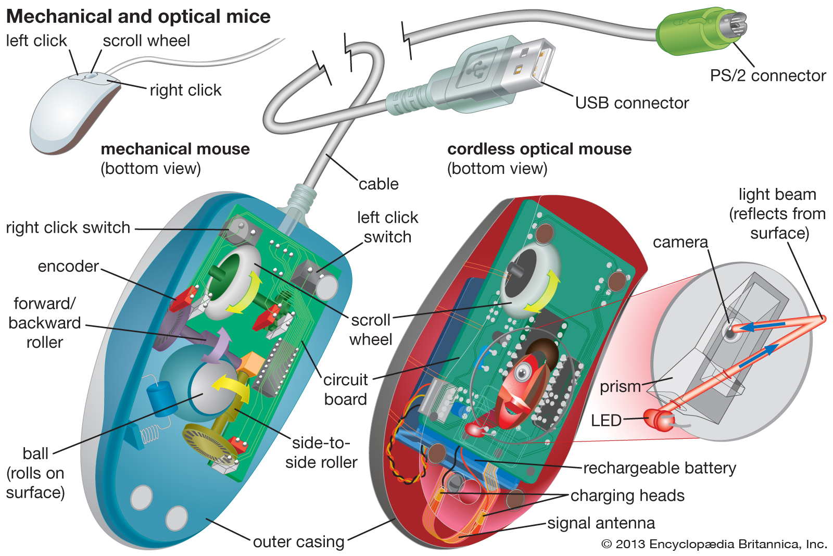
Peripherals
Peripheral device, also known as peripheral,computer peripheral, or input/output device, any of various devices (including sensors) used to enter information and instructions into a computer for storage or processing.

Slide 13
Computer Memory
Computer memory is binary (0 or 1) (on or off).
The byte is the standard unit of measurement.
A byte is composed of 8 bits (binary digits).
Typical units of measurement:
1 KB (kilobyte) = 1000 bytes
1 MB (megabyte) =1000 kilobytes or 1 million bytes
1 GB (gigabyte) =1000 megabytes or 1 billion bytes

Slide 14
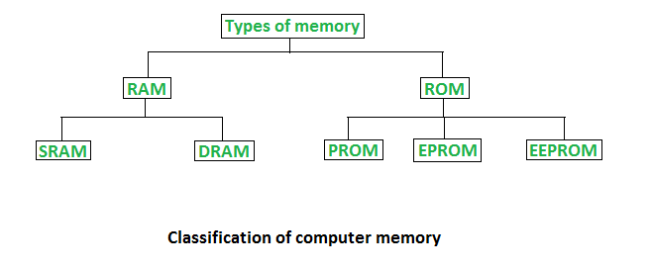
Memory Type
1. Random Access Memory (RAM) –
It is also called as read write memory or the main memory or the primary memory.
The programs and data that the CPU requires during execution of a program are stored in this memory.
It is a volatile memory as the data loses when the power is turned off.
RAM is further classified into two types- SRAM (Static Random Access Memory) and DRAM (Dynamic Random Access Memory).

Slide 15
Difference between DRAM and SRAM
DRAM | SRAM
1. Constructed of tiny capacitors | 1. Constructed of circuits (D flip-flops)
2.Requires recharge for maintaining data | 2.Holds its contents as long as power is available
3. Inexpensive | 3. Expensive
4.Slower than SRAM | 4.Faster than DRAM
5.Can store many bits per chip | 5.Can store many bits per chip
6.Uses less power | 6.Uses more power
7.Generates less heat | 7.Generates more heat
8.Used for main memory | 8.Used for cache

Slide 16
2. Read Only Memory (ROM) –
Stores crucial information essential to operate the system, like the program essential to boot the computer.
It is not volatile.
Always retains its data.
Used in embedded systems or where the programming needs no change.
Used in calculators and peripheral devices.
ROM is further classified into 4 types- ROM, PROM, EPROM, and EEPROM.
Types of Read Only Memory (ROM) –
A. PROM (Programmable read-only memory) – It can be programmed by user. Once programmed, the data and instructions in it cannot be changed.
B. EPROM (Erasable Programmable read only memory) – It can be reprogrammed. To erase data from it, expose it to ultra violet light. To reprogram it, erase all the previous data.
C. EEPROM (Electrically erasable programmable read only memory) – The data can be erased by applying electric field, no need of ultra violet light. We can erase only portions of the chip.

Slide 17
Difference between RAM & ROM
RAM | ROM
1. Temporary Storage | 1. Permanent Storage
2. Store data in MBs | 2. Store data in GBs
3. Volatile | 3. Non-Volatile
4. Used in normal operations | 4. Used for start-up process of computer
5. Writing data is faster | 6. Writing data is slower

Slide 18
Cache Memory
Cache memory is an extremely fast memory type that acts as a buffer between RAM and the CPU.
It holds frequently requested data and instructions so that they are immediately available to the CPU when needed.
Cache memory is used to reduce the average time to access data from the Main memory.
The cache is a smaller and faster memory which stores copies of the data from frequently used main memory locations.
CPU
Cache
Memory
Primary Memory
Secondary
Memory

Slide 19
Cache Memory
Levels of memory:
Level 1 or Register – It is a type of memory in which data is stored and accepted that are immediately stored in CPU. Most commonly used register is accumulator, Program counter, address register etc.
Level 2 or Cache memory – It is the fastest memory which has faster access time where data is temporarily stored for faster access.
Level 3 or Main Memory – It is memory on which computer works currently. It is small in size and once power is off data no longer stays in this memory.
Level 4 or Secondary Memory – It is external memory which is not as fast as main memory but data stays permanently in this memory.

Slide 20
Computer Registers
Registers are a type of computer memory used to quickly accept, store, and transfer data and instructions that are being used immediately by the CPU. The registers used by the CPU are often termed as Processor registers.
A processor register may hold an instruction, a storage address, or any data (such as bit sequence or individual characters).
The computer needs processor registers for manipulating data and a register for holding a memory address. The register holding the memory location is used to calculate the address of the next instruction after the execution of the current instruction is completed.

Slide 21
List of Common Registers
Register | Symbol | Number of bits | Function
Data register | DR | 16 | Holds memory operand
Address register | AR | 12 | Holds address for the memory
Accumulator | AC | 16 | Processor register
Instruction register | IR | 16 | Holds instruction code
Program counter | PC | 12 | Holds address of the instruction
Temporary register | TR | 16 | Holds temporary data
Input register | INPR | 8 | Carries input character
Output register | OUTR | 8 | Carries output character

Slide 22
Low –level Languages
A low-level language is a type of programming language that contains basic instructions recognized by a computer. Unlike high-level languages used by software developers, low-level code is often cryptic and not human-readable. Two common types of low-level programming languages are assembly language and machine language, eg: Assembly and Machine code.
Software programs and scripts are written in high-level languages, like C#, Swift, and PHP. A software developer can create and edit source code in a high-level language using a programming IDE or even a basic text editor. However, the code is not recognized directly by the CPU. Instead, it must be compiled into a low-level language.
Assembly language is one step closer to a high-level language than machine language. It includes commands such as MOV (move), ADD (add), and SUB (subtract). These commands perform basic operations, such as moving values into memory registers and performing calculations. Assembly language can be converted to the machine language using an assembler.
Machine language, or machine code, is the lowest level of computer languages. It contains binary code, often generated by compiling high-level source code for a specific processor. Most developers never need to edit or even look at machine code. Only programmers who build software compilers and operating systems need to view machine language. [2]

Slide 23
Languages
Between high-level language and machine language there are assembly language also called symbolic machine code. Assembly language are particularly computer architecture specific. Utility program (Assembler) is used to convert assembly code into executable machine code. High Level Programming Language are portable but require Interpretation or compiling to convert it into a machine language which is computer understood.
Hierarchy of computer language:
High level language
Assembly Language
Machine Language
Computer hardware

Slide 24
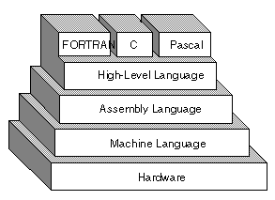
High–level Languages
A high-level language (HLL) is a programming language such as C, FORTRAN, or Pascal that enables a programmer to write programs that are more or less independent of a particular type of computer. Such languages are considered high-level because they are closer to human languages and further from machine languages.
In contrast, assembly languages are considered low-level because they are very close to machine languages. Ultimately, programs written in a high-level language must be translated into machine language by a compiler or interpreter.

Slide 25
SYSTEM SOFTWARE
System
Software

Slide 26
Assembler
An assembler is a program that converts assembly language into machine code. It takes the basic commands and operations from assembly code and converts them into binary code that can be recognized by a specific type of processor.
Assemblers are similar to compilers in that they produce executable code. However, assemblers are more simplistic since they only convert low-level code (assembly language) to machine code.
Most programs are written in high-level programming languages and are compiled directly to machine code using a compiler. However, in some cases, assembly code may be used to customize functions and ensure they perform in a specific way. Therefore, IDEs often include assemblers so they can build programs from both high and low-level languages. [1]
Assembly code
Assembler
Machine code

Slide 27
Compiler
Compilers, on the other hand, must convert generic high-level source code into machine code for a specific processor.
In computing, a compiler is a computer program that translates computer code written in one programming language into another language. The name "compiler" is primarily used for programs that translate source code from a high-level programming language to a lower-level language to create an executable program.
A compiler is likely to perform many or all of the following operations: preprocessing, lexical analysis, parsing, semantic analysis (syntax-directed translation), conversion of input programs to an intermediate representation, code optimization and code generation.

Slide 28
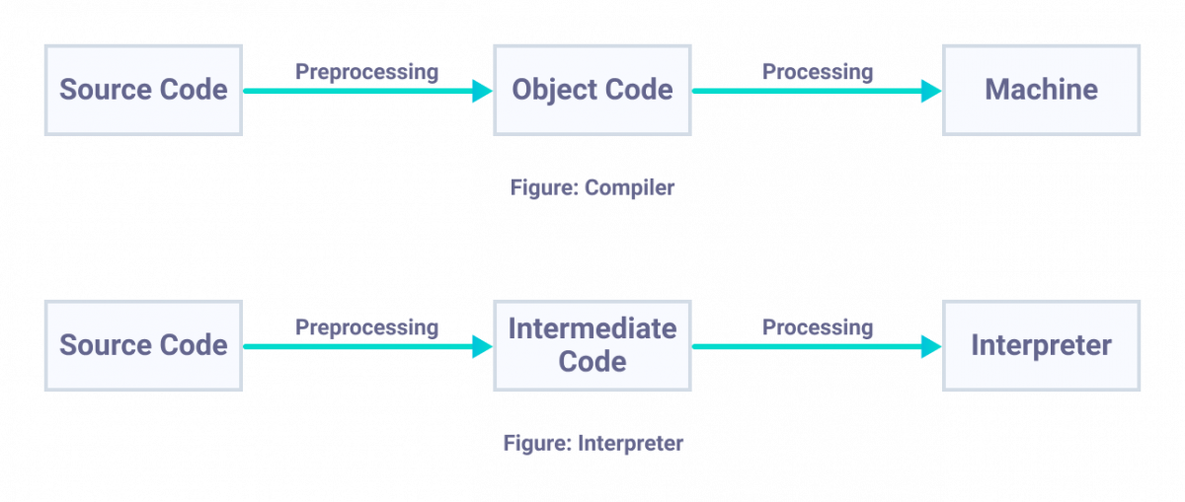
Interpreter
Interpreter is a program that executes instructions written in a high-level language. There are two ways to run programs written in a high-level language. The most common is to compile the program; the other method is to pass the program through an interpreter.

Slide 29
Interpreter Versus Compiler
Interpreter | Compiler
Translates program one statement at a time. | Scans the entire program and translates it as a whole into machine code.
Interpreters usually take less amount of time to analyze the source code. However, the overall execution time is comparatively slower than compilers. | Compilers usually take a large amount of time to analyze the source code. However, the overall execution time is comparatively faster than interpreters.
No intermediate object code is generated, hence are memory efficient. | Generates intermediate object code which further requires linking, hence requires more memory.
Programming languages like JavaScript, Python, Ruby use interpreters. | Programming languages like C, C++, Java use compilers.

Slide 30
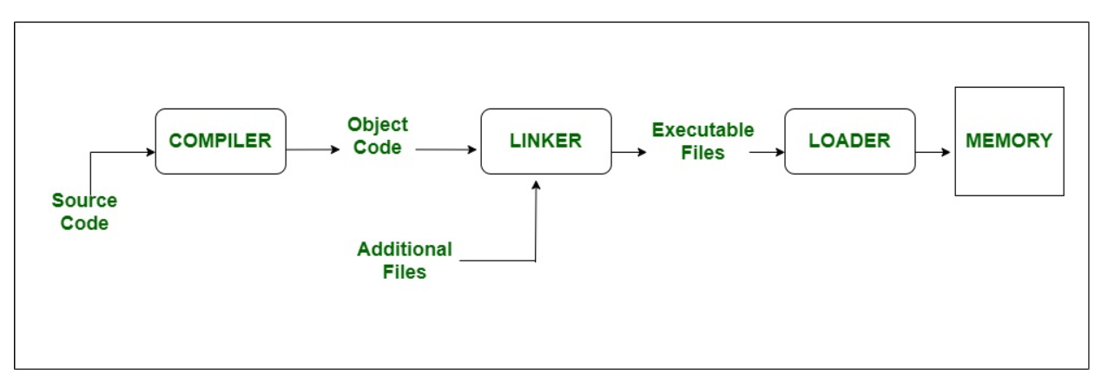
Loader/Linker
A linker is special program that combines the object files, generated by compiler/assembler, and other pieces of codes to originate an executable file have. exe extension. In the object file, linker searches and append all libraries needed for execution of file. It regulates memory space that code from each module will hold. It also merges two or more separate object programs and establishes link among them. Generally, linkers are of two types :
Linkage Editor
Dynamic linker

Slide 31
Loader/Linker
The loader is special program that takes input of object code from linker, loads it to main memory, and prepares this code for execution by computer. Loader allocates memory space to program. Even it settles down symbolic reference between objects. It in charge of loading programs and libraries in operating system. The embedded computer systems don’t have loaders. In them, code is executed through ROM. Generally, loader has three types of approach :
Absolute loading
Relocate loading
Dynamic run-time loading

Slide 32
Linker Versus Loader
S No. | LINKER | LOADER
1 | The main function of Linker is to generate executable files. | Whereas main objective of Loader is to executable files to main memory.
2 | The linker takes input of object code generated by compiler/assembler. | And the loader takes input of executable files generated by linker.
3 | Linking can be defined as process of combining various pieces of codes and source code to obtain executable code. | Loading can be defined as process of loading executable codes to main memory for further execution.
4 | Linker is of 2 types: Linkage Editor and Dynamic Linker. | Loader is of 3 types: Absolute loading, Relocatable loading and Dynamic run-time loading.
5 | Another use of linker is to combine all object modules. | It helps in allocating the address to executable codes/files.
6 | Linker is also responsible for arranging objects in program’s address space. | Loader is also responsible for adjusting references which are used within the program.

Slide 33
References
Christensson, P. (2014, September 5). Assembler Definition. Retrieved 2020, Dec 11, from https://techterms.com
Christensson, P. (2019, February 14). Low-Level Language Definition. Retrieved 2020, Dec 11, from https://techterms.com

